Slide 1


Prioritizing populations and positioning PrEP – How has it been working?
Key populations
Frances M Cowan
PrEP in Practice Symposium
International AIDS Society
28th July 2018
Notes:
1

Slide 2
Key populations bear brunt of HIV epidemic
In many settings less well engaged in testing, prevention and care
Results in high mortality and morbidity among KPs

Slide 3
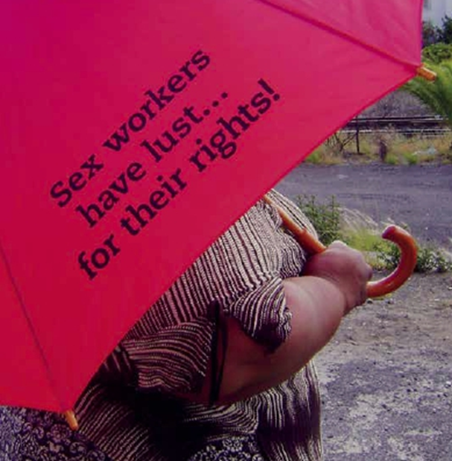
FSW
Globally FSW 13.5 times odds of HIV
  Even in generalised epidemics
  Prevalence
    Zimbabwe 58%
    Malawi 63%
    Kenya 29.5%
    South Africa 40-72%

Slide 4
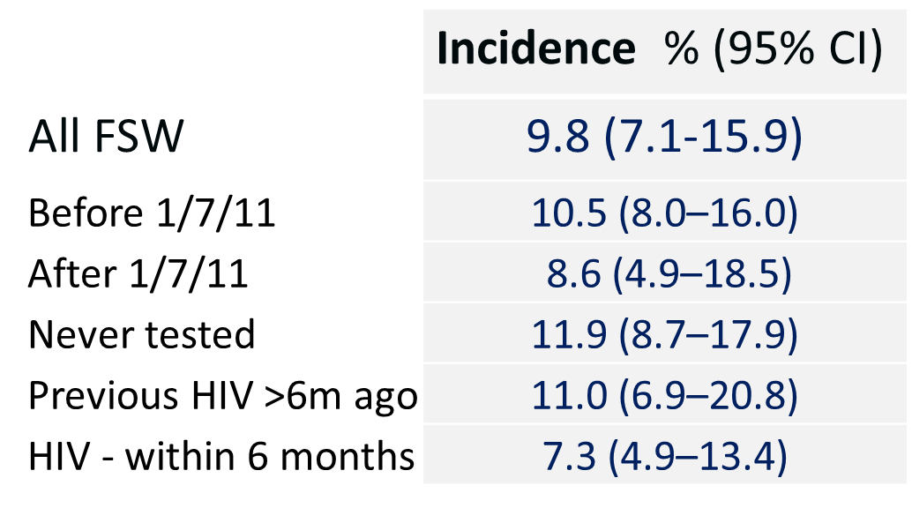
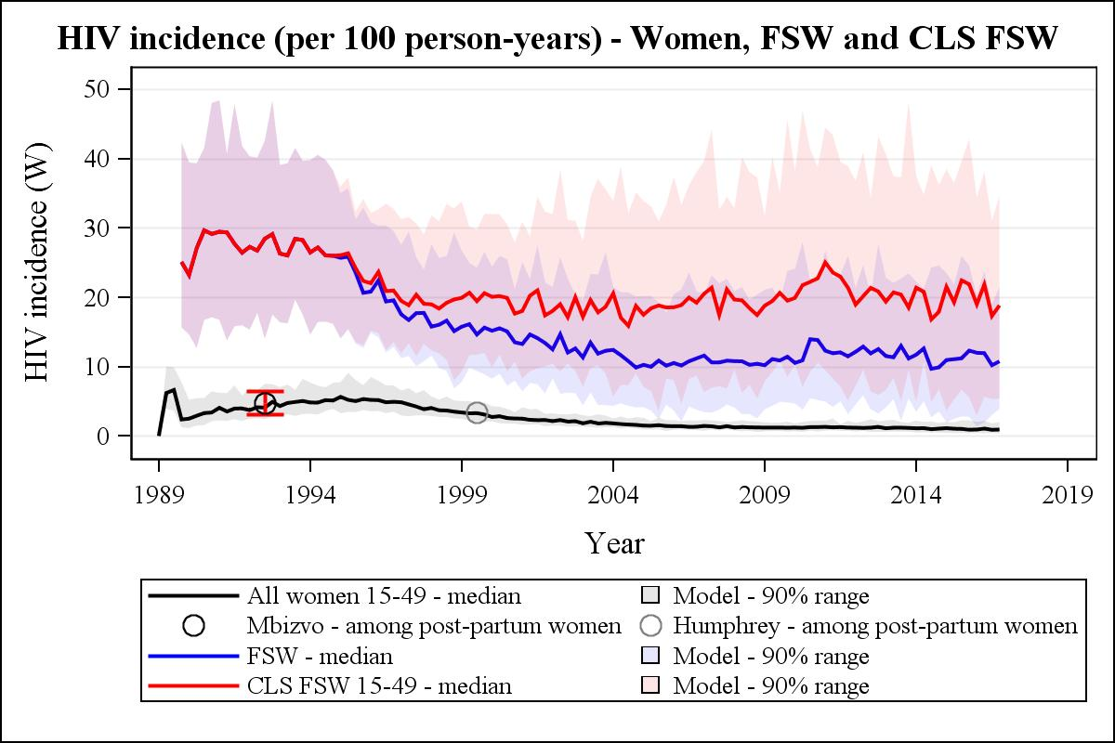
Estimated HIV incidence - Zimbabwe
Estimate using programme data
  2009-2013
  Based on >13,000 FSW
  Estimated in rpt testers
Estimated using modeling
  Individual HIV stochastic model parameterized to Zimbabwe
Hargreaves et al JAIDS 2015;72
Bansi Matharu, Cambiano, Phillips under review

Slide 5
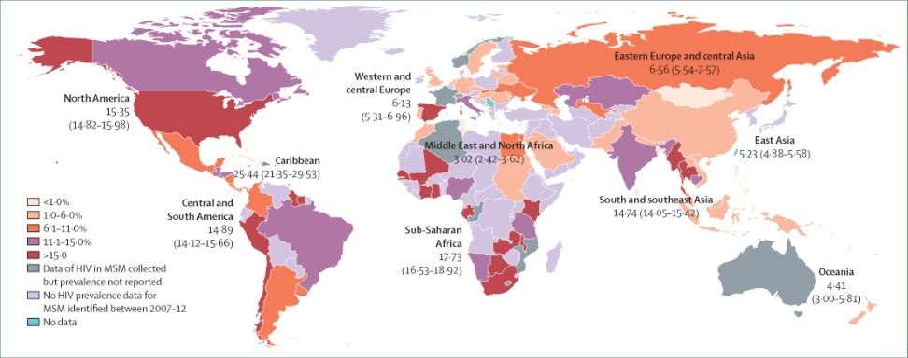
HIV Prevalence among MSM 2007-2016
No Evidence of Regional Differences in the Diversity of Sexual Orientations and Gender Identity
Evidence of Regional Differences
  Nomenclature and Outward Sexual and Gender Expression
  Social Acceptance
  Punitive and Protective Laws
Updated from: Beyrer, Baral, van Griensven, Goodreau, Chariyalertsak, Wirtz, Brookmeyer, The Lancet, 2012

Slide 6
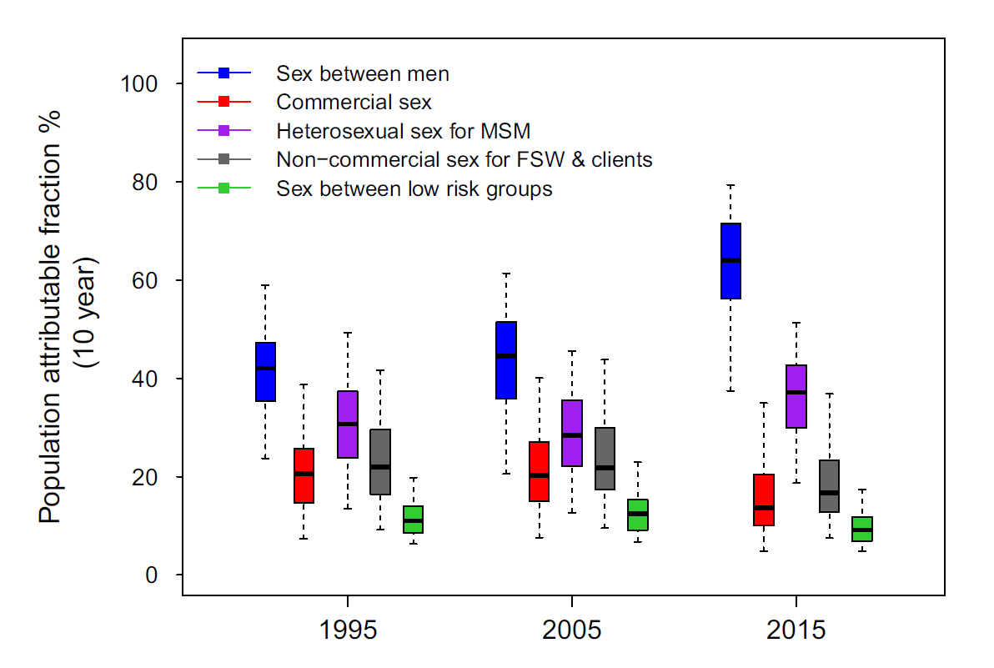
HIV Population Attributable Fraction In Senegal
Vickerman, Diouf, Toure Kane et al JIAS in press 2018

Slide 7
MSM
Many (but not all) at increased vulnerability of HIV
  Kenya factors associated with increased risk
    Young age (18-24)
    Only male partners
    Receptive AI
    Any condomless sex
    Any group sex
  In LMIC (and some HIC) incidence is high –
    Kilifi, Kenya 7/100 pyar overall but 35/100pyar (95% CI 32-50%) for MSM with only male partners
* AIDS and Behavior 2018 Wahome et al

Slide 8
Rationale for targeting
Modelling predicts PrEP will have greatest population-level efficacy if rapidly targeted, with high coverage, to those at high risk.
Potential advantages
  Only prescribed to target group (potentially minimizing number of prescriptions required)
  Provided through specific health services (may limit requirements for HCW training)
  Target group maybe well networked – opportunities for advocacy / marketing
  Target group at very high risk so potentially motivated to take up and adhere
Disadvantages
  Target population vulnerable for host of reasons – HIV just one
  Population may not be easily identifiable
  Targeting may increase their identifiability (stigma/ discrimination)

Slide 9
Example of when targeting a success
Well resourced setting
Political will
Limited stigma – population well networked (virtually and in reality)
Health services adapted to facilitate uptake and engagement
New South Wales
Scaling up ART in MSM had not resulted in incidence declines
Rapid scale up of PrEP over 6 months in 2016 to reach target enrolment
High uptake (>9000 by May 2018)
Rigorous programme monitoring
2 HIV infections in 3927 person-years during this period, or 0.05% a year
Able to demonstrate 35% reduction in MSM population incidence pre/post implementation
Grulich et al CROI 2018
Notes:
The decline in infections was mainly in older people: infections fell almost by half (down 46%) in people over 35, but only fell by 22% in people aged 25-34 and 9.5% in people aged 18-24. Infections fell by 49% in people born in Australia but only by 21% in people born in Asia and actually increased, by 25%, in people from areas other than Australia, high-income countries, and Asia. Numerically this was only an increase from 17 to 21 infections, but it was statistically significant.

Slide 10
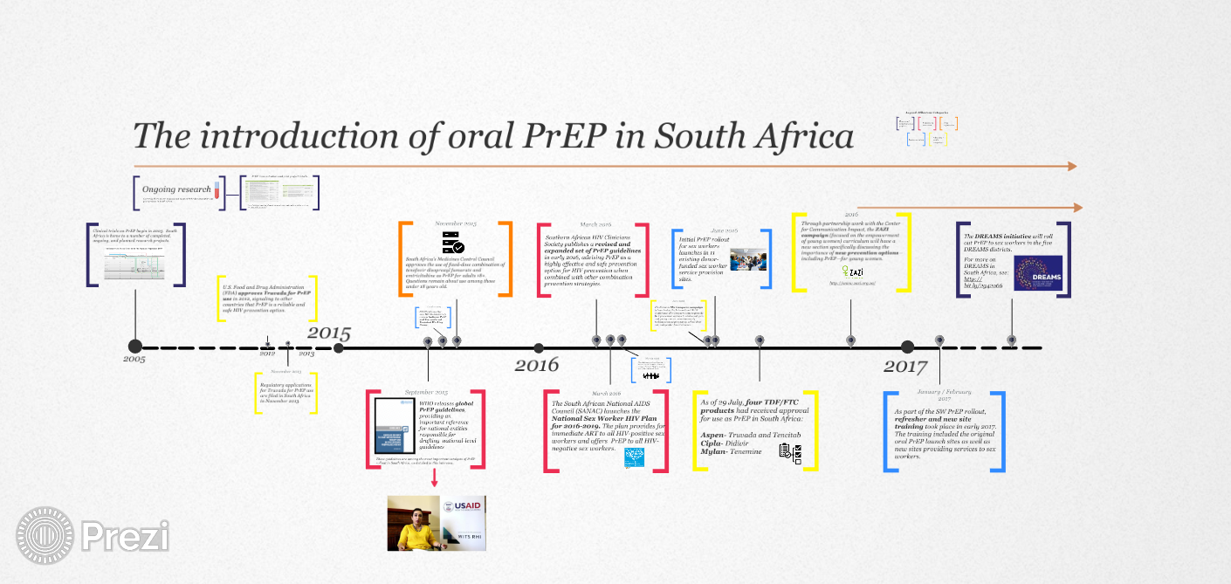
https://prezi.com/vauupptbmy07/the-introduction-of-oral-prep-in-south-africa/

Slide 11
TAPS demonstration study SA
Eakle et al PLoS Med 14(11): e1002444

Slide 12
South Africa
Female sex workers June 2016
Implementation guidelines developed
Clinics had to be ‘certified’ as PrEP ready, peer educator training etc
Variable uptake by site
Potential concerns that restricting to SW might stigmatise PrEP
  IEC/ mass media aimed at all
  Sex positive
MSM April 2017
Tertiary education clinics Nov 2017
25,000 – 30,000 to date

Slide 14
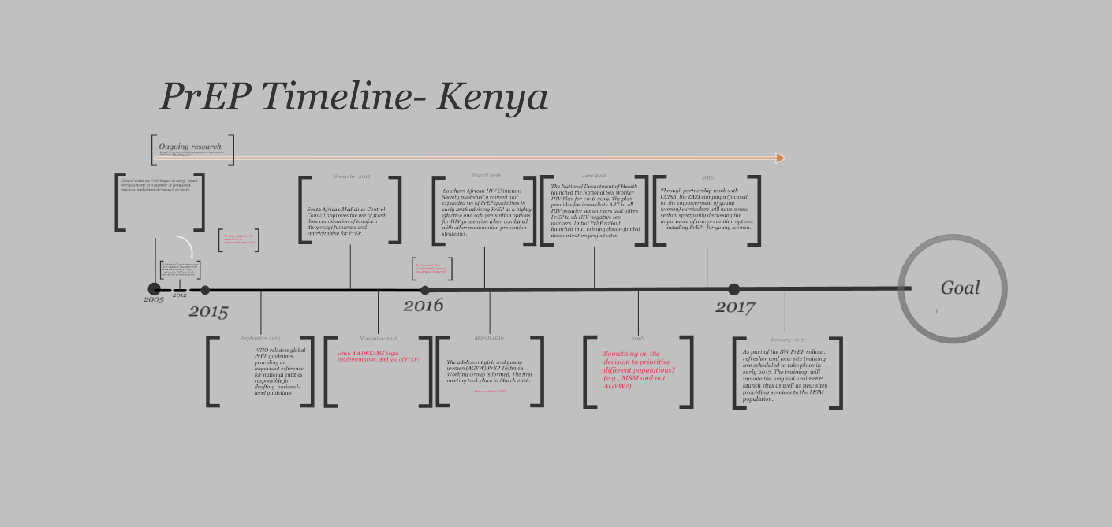
https://prezi.com/zhwobpcjncrx/prep-timeline-template-kenya/

Slide 15
Kenya
PrEP is offered to sexually active HIV-negative individuals who are at significant risk of acquiring HIV infection.
  Potential that those at highest risk are missed
≈ 25,000 PrEP users to date
<5,000 Jan-Jun 2018

Slide 16
Zimbabwe timeline
Demonstration project sex workers 2014-2016
MoHCC launched PrEP guidance within revised ART guidelines in June 2016
Implementation through PSI and selected MoHCC sites early 2017
The PrEP Implementation Strategy for Zimbabwe launched June 2018
Funding for PrEP included in GFATM and COPs with aim increase scale up over 2018-2020.

Slide 17

SW Zimbabwe
Within SAPPH-IRe trial
Uptake cautious
Early adopters were most likely to be retained
Qualitative data suggest ‘most assertive’ most likely to adopt
Reasons for non-adoption
  Paranoia – why is it just offered to us
  Inevitability of infection (lack of control about life and life events)
  Fear of status disclosure (including false disclosure HIV positive)
  Fear of side effects

Slide 18
Scale up in Zimbabwe
Five major cities through PSI
Two districts MoHCC sites
>5000 people initiated to date
  2017 - 2478
    > 50% FSW
    20% serodiscordant couples
    2% MSM
    1% TGW
  2018 – 2350
    >50% FSW
    12% serodiscordant couples
    20% MSM
    4% YWSS

Slide 19
Considerations
HCW workers important gate keepers
  training and sensitization critical
More information for communities
How do we best tailor adherence support for to individual and community needs?
  Can support be status neutral?
  Group/individual?
  Behavioural economics approach?
  Community?

Slide 20


Acknowledgements
Eduard Sanders Nelly Mugo
Naomi Hill Robyn Eakle
Sinead Delany Moretlwe
Emily Gwavava
Getrude Ncube

